Slide 1
Utilizing software to monitor project performance

Slide 2
Why do we need monitoring?
Monitoring project performance helps with:
tracking project progress
identifying delays and risks
improving decision-making
controlling deadlines
increasing team efficiency

Slide 3
User needs
As a project manager I should be able to:
track project progress
monitor task completion
analyze team performance
detect delays and bottlenecks
monitor deadlines and milestones
view reports and dashboards
track time and resource usage

Slide 4
Software functionalities
No | Functionality | Input | Output | Purpose | MoSCoW
1 | Track task status | Task updates | Status info | Monitor progress | Must
2 | Time tracking | Time logs | Time reports | Measure effort | Must
3 | Dashboard view | Task data | Visual overview | Quick monitoring | Must

Slide 5
No | Functionality | Input | Output | Purpose | MoSCoW
4 | Generate reports | Project data | Reports | Performance analysis | Should
5 | Notifications | Deadlines | Alerts | Stay updated | Could
6 | Task dependencies | Task links | Workflow | Control execution order | Must
7 | Timeline / Gantt | Task data | Timeline | Monitor schedule | Should

Slide 6
No | Functionality | Input | Output | Purpose | MoSCoW
8 | Performance analytics | Task data | Metrics | Analyze productivity | Should
9 | Progress tracking | Status updates | Progress view | Monitor completion | Must
10 | Update history | Task changes | History log | Track changes | Could
11 | Resource tracking | Resource data | Usage report | Optimize workload | Should

Slide 7
Comparative price analysis

Slide 8
Asana
Producer: Asana Inc. Platform: Web-based
Free plan: Available (basic task and project management features)
Paid plans:
Starter: €10.99 per user/month (annual billing)
Advanced: €24.99 per user/month (annual billing)
Enterprise: custom pricing
Offers advanced task and project management, workflow automation, reporting, and AI-powered features. Higher tiers unlock tools like timelines, portfolios, goals, and deeper integrations.
Key advantage: Strong collaboration and task management features Main drawback: Pricing structure can become expensive as teams scale (per-user model)

Slide 9
monday.com
Producer: monday.com Platform: Web-based Free plan: Available (limited to 2 users)
Paid plans:
Basic: ~€8–11 per user/month
Standard: ~€11–14 per user/month
Pro: ~€18–24 per user/month
Enterprise: custom pricing
Offers advanced automation, customizable workflows, dashboards, and collaboration tools, with higher tiers unlocking more integrations, reporting, and automation limits.
Key advantage: Highly customizable and visual project management interface Main drawback: Pricing scales quickly with team size due to per-user (seat-based) model

Slide 10
Jira
Producer: Atlassian Platform: Web-based (Cloud; also available as self-hosted/Data Center)
Free plan: Available (for up to 10 users, includes basic Scrum/Kanban boards and reporting)
Paid plans:
Standard: ~€7–9 per user/month
Premium: ~€14–18 per user/month
Enterprise: custom pricing
Offers advanced issue tracking, agile project management (Scrum/Kanban), automation, reporting, and deep integration with the Atlassian ecosystem. Higher tiers unlock features like advanced roadmaps, automation limits, and enterprise-grade controls.
Key advantage: Powerful and highly flexible for agile software development Main drawback: Steep learning curve and can be difficult to set up and manage

Slide 11
Functional comparision

Slide 12
Feature | monday.com | Jira | Asana
Track status | Tasks have customizable status columns that clearly show progress and can be updated in real time. | Status is managed through workflows and issue states, which can be customized but are more complex. | Tasks can be marked as complete or organized into sections representing different stages.
Time tracking | Time tracking is available through integrations or built-in features in higher plans. | Time tracking is supported and can be extended with plugins for detailed reporting. | Time tracking is limited and mostly available in paid plans or through integrations.
Reports | Dashboards provide visual reports with charts and metrics for monitoring performance. | Advanced reporting with customizable dashboards and detailed analytics is available. | Reports are available through dashboards, but some advanced features require paid plans.

Slide 13
Feature | monday.com | Jira | Asana
Dashboard | Highly visual dashboards allow easy monitoring of project performance and team workload. | Dashboards are powerful but more technical and require configuration. | Dashboards are simple and easy to use, focused on task overview and progress.
Dependencies | Dependencies can be set between tasks and visualized in timeline views. | Dependencies are supported and can be managed within issue linking and planning tools. | Dependencies can be created, especially in timeline view, to manage task order.

Slide 14
Software chosen - monday.com
includes free tier
web-based
very visual interface
strong monitoring tools
easy to use
ideal for dashboards

Slide 15
Software demonstration

Slide 16
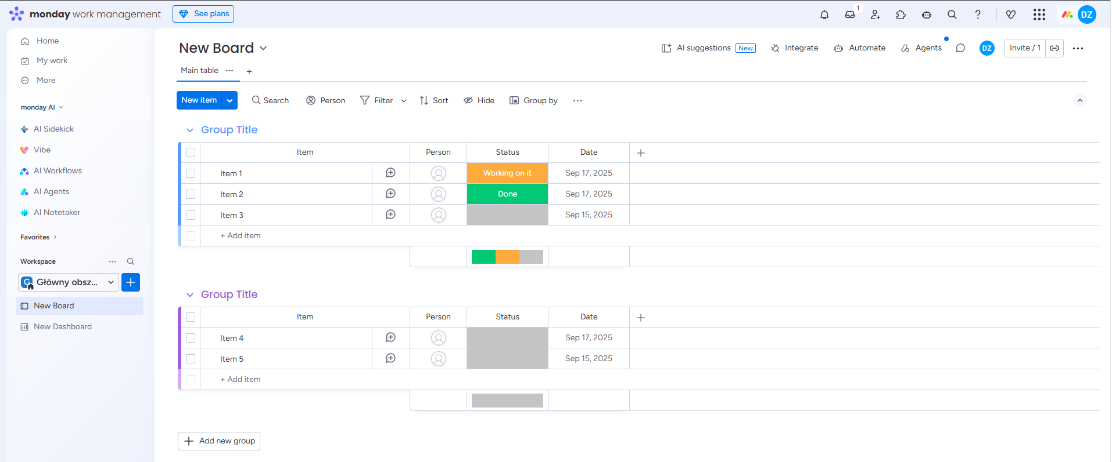

Slide 17
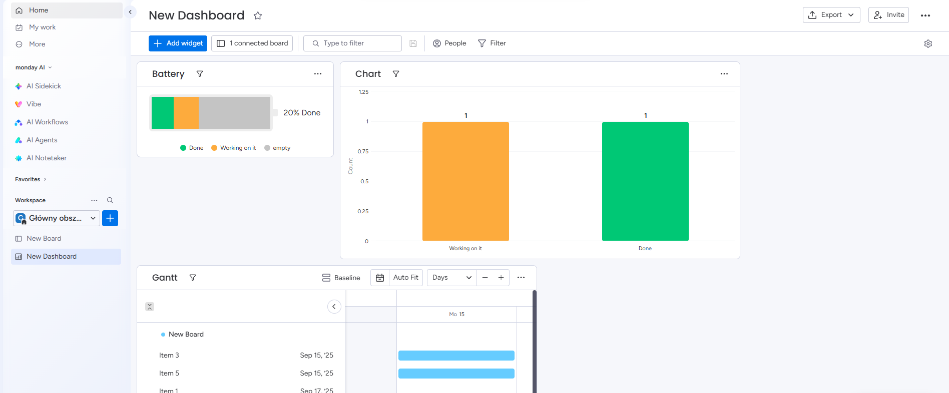

Slide 18
Tasks
Task 1.
Create a board in monday.com, add 6–8 tasks, and assign status, deadlines, and team members. Add custom fields such as task difficulty and estimated time.
Task 2.
Create a dashboard, add basic widgets, and analyze task progress, delays, and workload distribution.

